Slide 1
WIA1005 Network Technology Foundation
Chapter 12
Wireless LAN

Slide 2
Contents
Introduction
WLAN Components
WLAN Operation
WLAN Threats
WLAN Configuration

Slide 3
Introduction
A Wireless LAN (WLAN) is a type of wireless network that is commonly used in homes, offices, and campus environments.
WLAN supports people who are on the move. It’s the WLAN that makes mobility possible within the home and business environments.
In businesses, there can be a cost savings any time equipment changes, or when relocating an employee within a building, reorganizing equipment or a lab, or moving to temporary locations or project sites.
A wireless infrastructure can adapt to rapidly changing needs and technologies.

Slide 4
Introduction
Wireless technology uses the unlicensed radio spectrum to send and receive data. The spectrum is accessible to any wireless devices. Wireless networks can be classified broadly into four main types: WPAN, WLAN, WMAN, and WWAN.
Wireless Personal-Area Networks (WPAN) - Uses low powered transmitters for a short-range network, usually 6 to 9 meters. Bluetooth and ZigBee based devices are commonly used in WPANs. WPANs are based on the 802.15 standard and a 2.4-GHz radio frequency.
  Bluetooth Low Energy (BLE) - Mesh topology to large scale network devices.
  Bluetooth Basic Rate/Enhanced Rate (BR/EDR) - Point to point topologies and is optimized for audio streaming.

Slide 5
Introduction
Wireless LANs (WLAN) - Uses transmitters to cover a medium-sized network, usually up to 100 meters. WLANs are suitable for use in a home, office, and even a campus environment. WLANs are based on the 802.11 standard and a 2.4-GHz or 5-GHz radio frequency.
Wireless MANs (WMAN) - Uses transmitters to provide wireless service over a larger geographic area. WMANs are suitable for providing wireless access to a metropolitan city or specific district.

Slide 6
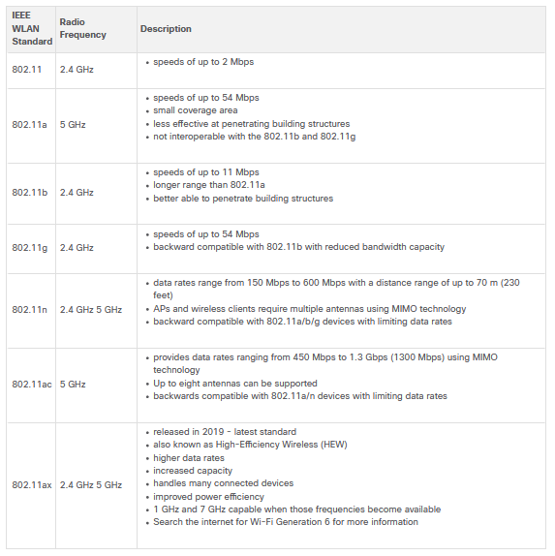

Slide 7
Introduction
Wireless Wide-Area Networks (WWANs) - Uses transmitters to provide coverage over an extensive geographic area. WWANs are suitable for national and global communications.
  WiMAX (Worldwide Interoperability for Microwave Access) - WiMAX is an IEEE 802.16 WWAN standard that provides high-speed wireless broadband access of up to 30 miles (50 km). WiMAX operates in a similar way to Wi-Fi, but at higher speeds, over greater distances, and for a greater number of users. It uses a network of WiMAX towers that are similar to cell phone towers.

Slide 8
Introduction
  Cellular Broadband - Cellular 4G/5G are wireless mobile networks primarily used by cellular phones but can be used in automobiles, tablets, and laptops. Cellular networks are multi-access networks carrying both data and voice communications. A cell site is created by a cellular tower transmitting signals in a given area.
  Satellite Broadband - Provides network access to remote sites through the use of a directional satellite dish that is aligned with a specific geostationary Earth orbit satellite. It is usually more expensive and requires a clear line of sight. Typically, it is used in rural areas.

Slide 9
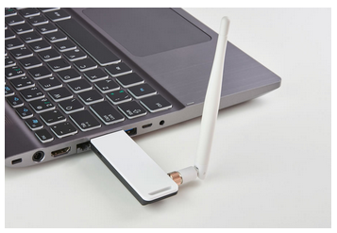
WLAN Components
Wireless deployments require a minimum of two devices that have a radio transmitter and a radio receiver tuned to the same radio frequencies:
  End devices with wireless NICs
  A network device, such as a wireless router or wireless AP

Slide 10
WLAN Components
A home user typically interconnects wireless devices using a small, wireless router:
  Access point - This provides 802.11a/b/g/n/ac wireless access.
  Switch - This provides a four-port, full-duplex, 10/100/1000 Ethernet switch to interconnect wired devices.
  Router - This provides a default gateway for connecting to other network infrastructures, such as the internet.

Slide 11
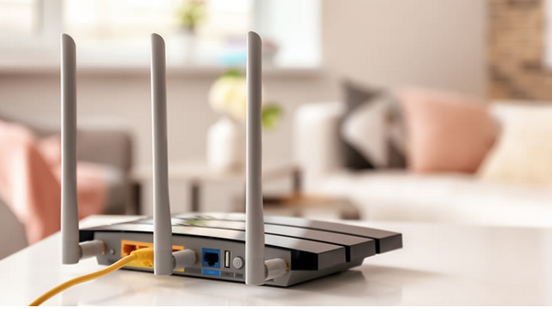
WLAN Components
The wireless router advertises its wireless services by sending beacons containing its shared service set identifier (SSID).
Wireless devices discover the SSID and attempt to associate and authenticate with it to access the local network and internet.

Slide 12
WLAN Components
Wireless access point provides dedicated wireless access to the user devices.
Autonomous APs - Autonomous APs are useful in situations where only a couple of APs are required in the organization. A home router is an example of an autonomous AP because the entire AP configuration resides on the device. Each AP would operate independent of other APs and each AP would require manual configuration and management.
Controller-based Aps - These devices require no initial configuration and are often called lightweight APs (LAPs). There are useful in situations where many APs are required in the network.

Slide 13
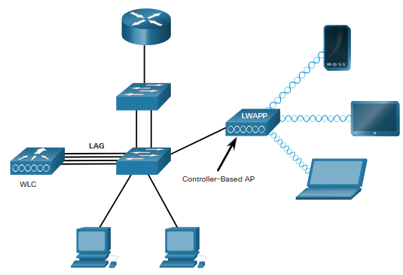
WLAN Components
LAPs use the Lightweight Access Point Protocol (LWAPP) to communicate with a WLAN controller (WLC). Each AP is automatically configured and managed by the WLC.
WLC has four ports connected to the switching infrastructure. (Link aggregation group - LAG). LAG provides redundancy and load-balancing.

Slide 14
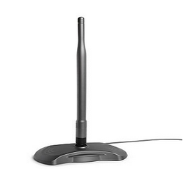
WLAN Components
Most APs require external antennas to make them fully functioning units.
Omnidirectional antennas - Provide 360-degree coverage and are ideal in houses, open office areas, conference rooms, and outside areas.

Slide 15
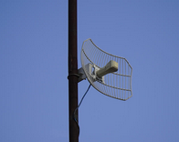
WLAN Components
Directional antennas focus the radio signal in a given direction. This enhances the signal to and from the AP in the direction the antenna is pointing This provides a stronger signal strength in one direction and reduced signal strength in all other directions.
Examples of directional Wi-Fi antennas include Yagi and parabolic dish antennas.

Slide 16
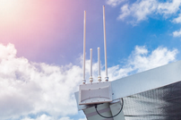
WLAN Components
Multiple Input Multiple Output (MIMO) uses multiple antennas to increase available bandwidth for IEEE 802.11n/ac/ax wireless networks.
Up to eight transmit and receive antennas can be used to increase throughput.

Slide 17
WLAN Operation
The 802.11 standard consists of Ad hoc, Infrastructure and tethering mode.
Ad hoc mode - This is when two devices connect wirelessly in a peer-to-peer (P2P) manner without using APs or wireless routers. (Bluetooth or Wi-Fi Direct). Also named as Independent Basic Service Set (IBSS).
Infrastructure mode - This is when wireless clients interconnect via a wireless router or AP, such as in WLANs. APs connect to the network infrastructure using the wired distribution system, such as Ethernet.
Infrastructure mode defines two topology building blocks: Basic Service Set (BSS) and an Extended Service Set (ESS).

Slide 18
WLAN Operation
Basic Service Set consists of a single AP interconnecting all associated wireless clients. If a wireless client moves out of its BSA, it can no longer directly communicate with other wireless clients within the BSA. The Layer 2 MAC address of the AP is used to uniquely identify each BSS, which is called the Basic Service Set Identifier (BSSID).
Extended Service Set - Two or more BSSs can be joined through a common distribution system (DS) into an ESS. An ESS is the union of two or more BSSs interconnected by a wired DS.
Each ESS is identified by a SSID and each BSS is identified by its BSSID.

Slide 19
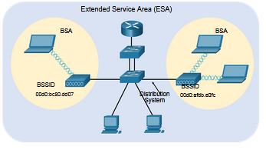
WLAN Operation
Wireless clients in one BSA can now communicate with wireless clients in another BSA within the same ESS. Roaming mobile wireless clients may move from one BSA to another (within the same ESS) and seamlessly connect.

Slide 20
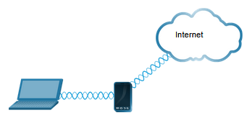
WLAN Threats
Tethering - A variation of the ad hoc topology is when a smart phone or tablet with cellular data access is enabled to create a personal hotspot. A hotspot is usually a temporary quick solution that enables a smart phone to provide the wireless services of a Wi-Fi router. Other devices can associate and authenticate with the smart phone to use the internet connection.

Slide 21
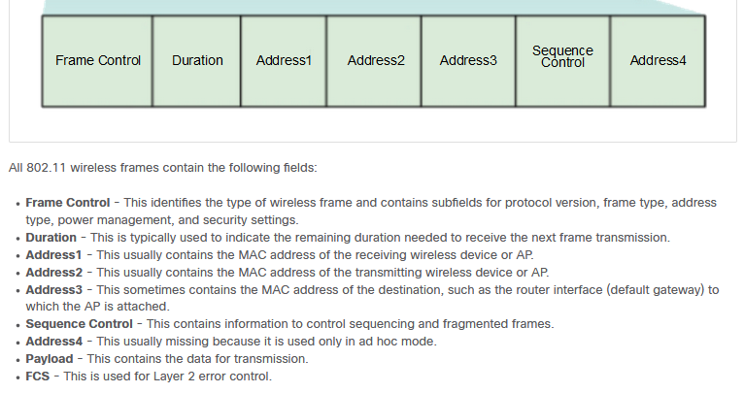
WLAN Operation
802.11 Frame Structure

Slide 22
WLAN Operation
WLANs are half-duplex. WLANs use carrier sense multiple access with collision avoidance (CSMA/CA) as the method to determine how and when to send data on the network.
A wireless client does the following:
  Listens to the channel to see if it is idle, which means that is senses no other traffic is currently on the channel.
  Sends a ready to send (RTS) message to the AP to request dedicated access to the network.
  Receives a clear to send (CTS) message from the AP granting access to send.

Slide 23
WLAN Operation
  If the wireless client does not receive a CTS message, it waits a random amount of time before restarting the process.
  After it receives the CTS, it transmits the data.
  All transmissions are acknowledged. If a wireless client does not receive an acknowledgement, it assumes a collision occurred and restarts the process.

Slide 24
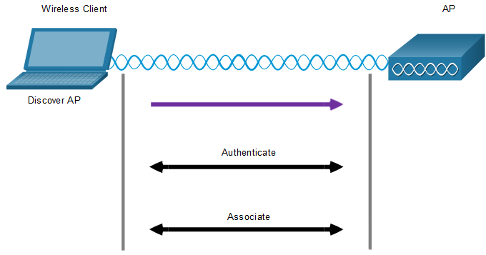
WLAN Operation
Wireless devices that need to communicate over a network must first associate with an AP or wireless router.
  Discover a wireless AP
  Authenticate with AP
  Associate with AP

Slide 25
WLAN Operation
In order to have a successful association, a wireless client and an AP must agree on specific parameters.
SSID -The SSID name appears in the list of available wireless networks on a client. Several APs on a network can share a common SSID.
Password - This is required from the wireless client to authenticate to the AP.
Network mode - This refers to the 802.11a/b/g/n/ac/ad WLAN standards. APs and wireless routers can operate in a Mixed mode meaning that they can simultaneously support clients connecting via multiple standards.

Slide 26
WLAN Operation
Security mode - This refers to the security parameter settings, such as WEP, WPA, or WPA2. Always enable the highest security level supported.
Channel settings - This refers to the frequency bands used to transmit wireless data. Wireless routers and APs can scan the radio frequency channels and automatically select an appropriate channel setting. The channel can also be set manually if there is interference with another AP or wireless device.

Slide 27
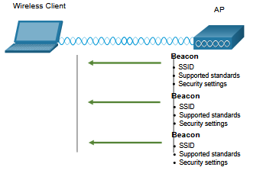
WLAN Operation
In passive mode, the AP openly advertises its service by periodically sending broadcast beacon frames containing the SSID, supported standards, and security settings.
The primary purpose of the beacon is to allow wireless clients to learn which networks and APs are available in a given area. This allows the wireless clients to choose which network and AP to use.

Slide 28
WLAN Operation
In active mode, wireless clients must know the name of the SSID. The wireless client initiates the process by broadcasting a probe request frame on multiple channels. The probe request includes the SSID name and standards supported.
APs configured with the SSID will send a probe response that includes the SSID, supported standards, and security settings.
Active mode may be required if an AP or wireless router is configured to not broadcast beacon frames.
A wireless client could also send a probe request without a SSID name to discover nearby WLAN networks.

Slide 29
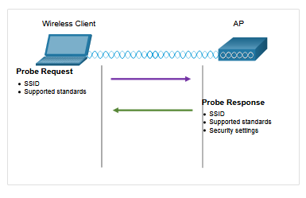
WLAN Operation

Slide 30
WLAN Operation
CAPWAP is an IEEE standard protocol that enables a WLC to manage multiple APs and WLANs. CAPWAP is also responsible for the encapsulation and forwarding of WLAN client traffic between an AP and a WLC.
CAPWAP is based on LWAPP but adds additional security with Datagram Transport Layer Security (DTLS).
CAPWAP establishes tunnels on User Datagram Protocol (UDP) ports. CAPWAP can operate either over IPv4 or IPv6.
CAPWAP
  AP MAC Functions
  WLC MAC Functions

Slide 31
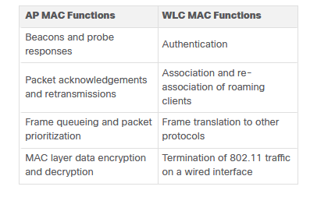
WLAN Operation

Slide 32
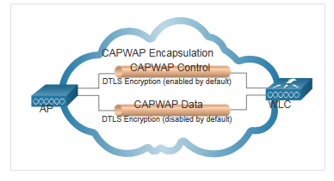
WLAN Operation
DTLS is a protocol which provides security between the AP and the WLC. It allows them to communicate using encryption and prevents eavesdropping or tampering.
All CAPWAP management and control traffic exchanged between an AP and WLC is encrypted and secured by default to provide control plane privacy and prevent Man-In-the-Middle (MITM) attacks.

Slide 33
WLAN Operation
FlexConnect is a wireless solution for branch office and remote office deployments. It lets you configure and control access points in a branch office from the corporate office through a WAN link, without deploying a controller in each office.
Connected mode - The WLC is reachable. In this mode the FlexConnect AP has CAPWAP connectivity with its WLC and can send traffic through the CAPWAP tunnel.
Standalone mode - The WLC is unreachable. The FlexConnect has lost or failed to establish CAPWAP connectivity with its WLC. A FlexConnect AP can assume some of the WLC functions such as switching client data traffic locally and performing client authentication locally.

Slide 34
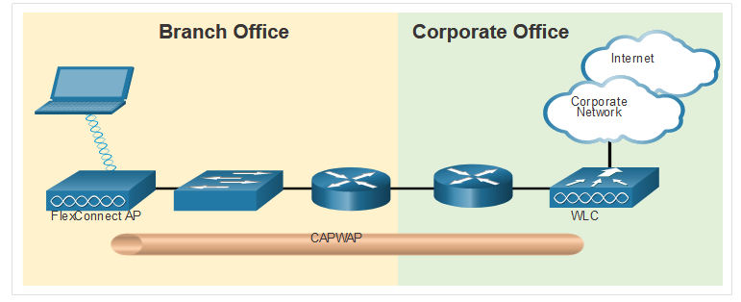
WLAN Operation

Slide 35
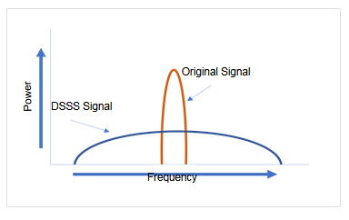
WLAN Operation
Direct-Sequence Spread Spectrum (DSSS) - This is a modulation technique designed to spread a signal over a larger frequency band. A properly configured receiver can reverse the DSSS modulation and re-construct the original signal. DSSS is used by 802.11b devices to avoid interference from other devices using the same 2.4 GHz frequency.

Slide 36
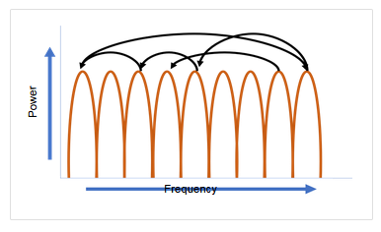
WLAN Operation
Frequency-Hopping Spread Spectrum (FHSS) - This relies on spread spectrum methods to communicate. It transmits radio signals by rapidly switching a carrier signal among many frequency channels.
With the FHSS, the sender and receiver must be synchronized to “know” which channel to jump to. This channel hopping process allows for a more efficient usage of the channels, decreasing channel congestion.

Slide 37
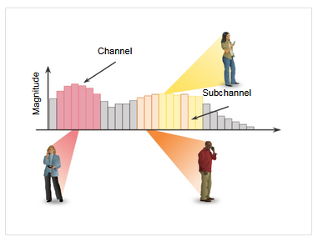
WLAN Operation
Orthogonal Frequency-Division Multiplexing (OFDM) - This is a subset of frequency division multiplexing in which a single channel uses multiple sub-channels on adjacent frequencies. Sub-channels in an OFDM system are precisely orthogonal to one another which allow the sub-channels to overlap without interfering. OFDM is used by a number of communication systems including 802.11a/g/n/ac. The new 802.11ax uses a variation of OFDM called Orthogonal frequency-division multiaccess (OFDMA).

Slide 38
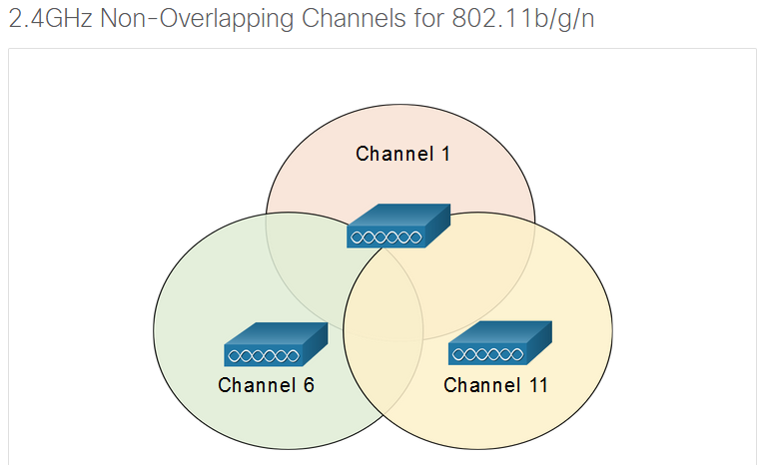
WLAN Operation

Slide 39
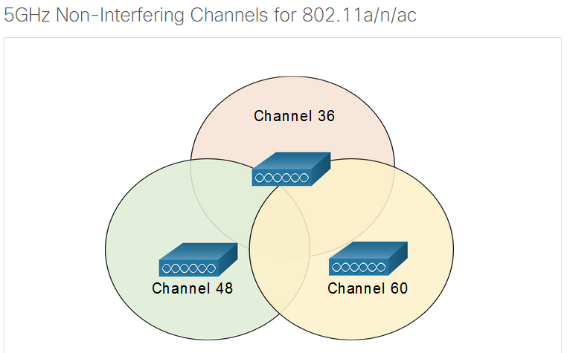
WLAN Operation

Slide 40
WLAN Threats
A WLAN is open to anyone within range of an AP and the appropriate credentials to associate to it. With a wireless NIC and knowledge of cracking techniques, an attacker may not have to physically enter the workplace to gain access to a WLAN.
Attacks can be generated by outsiders, disgruntled employees, and even unintentionally by employees.

Slide 41
WLAN Threats
Wireless networks are specifically susceptible to several threats, including:
  Interception of data – Data is being read by eavesdroppers.
  Wireless intruders - Unauthorized users attempting to access network resources.
  Denial of Service (DoS) Attacks - Access to WLAN services can be compromised either accidentally or maliciously.
  Rogue APs - Unauthorized APs installed by a well-intentioned user.

Slide 42
WLAN Threats
Wireless DoS attacks can be the result of:
  Improperly configured devices - Configuration errors can disable the WLAN.
  A malicious user intentionally interfering with the wireless communication - Their goal is to disable the wireless network completely or to the point where no legitimate device can access the medium.
  Accidental interference - WLANs are prone to interference from other wireless devices including microwave ovens, cordless phones, baby monitors, and more. The 2.4 GHz band is more prone to interference than the 5 GHz band.

Slide 43
WLAN Threats
A rogue AP is an AP or wireless router that has been connected to a corporate network without explicit authorization and against corporate policy.
Once connected, the rogue AP can be used by an attacker to capture MAC addresses, capture data packets, gain access to network resources, or launch a man-in-the-middle attack.
A personal network hotspot could also be used as a rogue AP. To prevent the installation of rogue APs, organizations must configure WLCs with rogue AP policies, and use monitoring software to actively monitor the radio spectrum for unauthorized APs.

Slide 44
WLAN Threats
“evil twin AP” attack is an attack where an attacker introduces a rogue AP and configures it with the same SSID as a legitimate AP.
Locations offering free Wi-Fi, such as airports, cafes, and restaurants, are particularly popular spots for this type of attack due to the open authentication.
Wireless clients attempting to connect to a WLAN would see two APs with the same SSID offering wireless access. Those near the rogue AP find the stronger signal and most likely associate with it.
User traffic is now sent to the rogue AP, which in turn captures the data and forwards it to the legitimate AP.

Slide 45
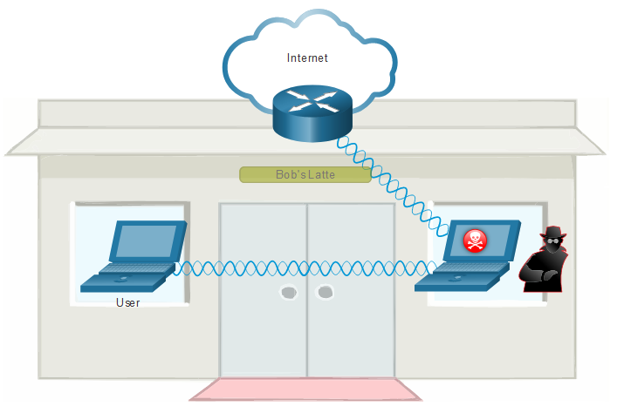
WLAN Threats

Slide 46
WLAN Threats
To address the threats of keeping wireless intruders out and protecting data SSID cloaking and MAC address filtering can be used.
SSID Cloaking - Disable the SSID beacon. Wireless clients must manually configure the SSID to connect to the network.
MAC Address Filtering - An administrator can manually permit or deny clients wireless access based on their physical MAC hardware address.
However, SSIDs are easily discovered even if APs do not broadcast them and MAC addresses can be spoofed. The best way to secure a wireless network is to use authentication and encryption systems.

Slide 47
WLAN Threats
Two types of authentication:
  Open system authentication - Any wireless client should easily be able to connect. The wireless client is responsible for providing security such as using a virtual private network (VPN) to connect securely.
  Shared key authentication - Provides mechanisms, such as WEP, WPA, WPA2, and WPA3 to authenticate and encrypt data between a wireless client and AP. However, the password must be pre-shared between both parties to connect.

Slide 48
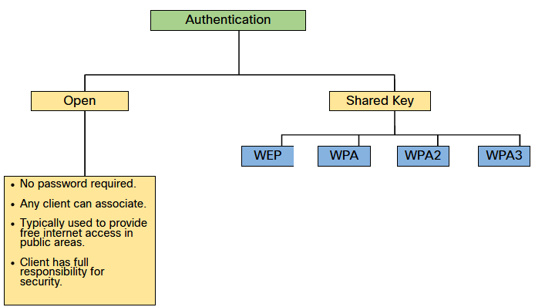
WLAN Threats

Slide 49
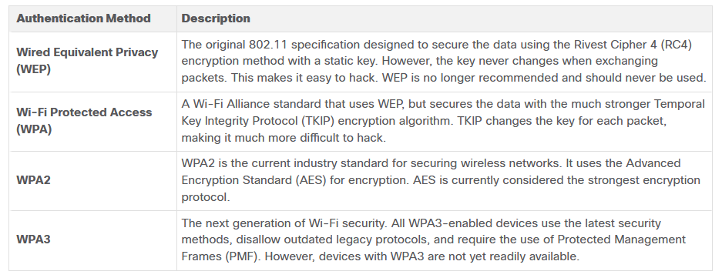
WLAN Threats

Slide 50
WLAN Threats
Home routers typically have two choices for authentication: WPA and WPA2.
  Personal - Intended for home or small office networks, users authenticate using a pre-shared key (PSK). Wireless clients authenticate with the wireless router using a pre-shared password.
  Enterprise - Intended for enterprise networks but requires a Remote Authentication Dial-In User Service (RADIUS) authentication server. The device must be authenticated by the RADIUS server and then users must authenticate using 802.1X standard, which uses the Extensible Authentication Protocol (EAP) for authentication.

Slide 51
WLAN Threats
The WPA and WPA2 standards use the following encryption protocols:
  Temporal Key Integrity Protocol (TKIP) - Used by WPA. It makes use of WEP, but encrypts the Layer 2 payload using TKIP, and carries out a Message Integrity Check (MIC) in the encrypted packet to ensure the message has not been altered.
  Advanced Encryption Standard (AES) - Used by WPA2. It uses the Counter Cipher Mode with Block Chaining Message Authentication Code Protocol (CCMP) that allows destination hosts to recognize if the encrypted and non-encrypted bits have been altered.

Slide 52
WLAN Threats
WPA3 includes four features:
  WPA3-Personal - Simultaneous Authentication of Equals (SAE) where the PSK is never exposed, making it impossible for the threat actor to guess.
  WPA3-Enterprise - Uses 802.1X/EAP authentication. However, it requires the use of a 192-bit cryptographic suite and eliminates the mixing of security protocols for previous 802.11 standards. WPA3-Enterprise adheres to the Commercial National Security Algorithm (CNSA) Suite which is commonly used in high security Wi-Fi networks.

Slide 53
WLAN Threats
  Open Networks - Open or public Wi-Fi networks do not use any authentication but using Opportunistic Wireless Encryption (OWE) to encrypt all wireless traffic.
  IoT Onboarding - The Device Provisioning Protocol (DPP) was designed to address this need where each headless device has a hardcoded public key. The key is typically stamped on the outside of the device or its packaging as a Quick Response (QR) code.

Slide 54
WLAN Configuration
Wireless Router Basic Setup:
  Log in to the router from a web browser.
  Change the default administrative password.
  Log in with the new administrative password.
  Change the default DHCP IPv4 addresses.
  Renew the IP address.
  Log in to the router with the new IP address.

Slide 55
WLAN Configuration
Basic Wireless Setup:
  Change the network mode
  Configure the SSID
  Configure the channel
  Configure the security mode
  Configure the passphrase

Slide 56
WLAN Configuration
Basic WLAN configuration on the WLC:
  Create the WLAN
  Apply and Enable the WLAN
  Select the Interface
  Secure the WLAN
  Verify the WLAN is Operational
  Monitor the WLAN
  View Wireless Client Information

Slide 57
WLAN Configuration
Others configuration on the WLC:
  Configuring SNMP and RADIUS services
  Configure new interface (VLAN)
  Configure DHCP scope (pool)
  Configure WPA2 Enterprise WLAN

